Slide 1
Python

Slide 2
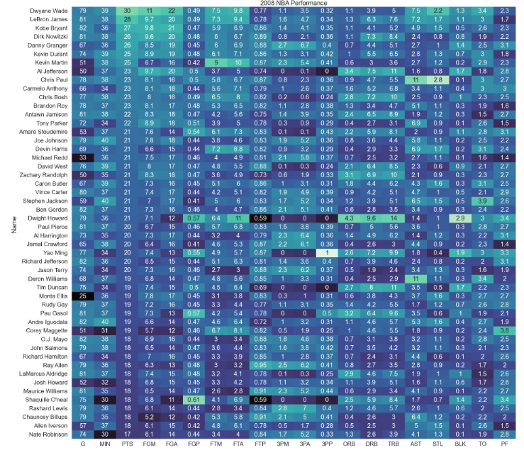
Python – Heat Map

Slide 3
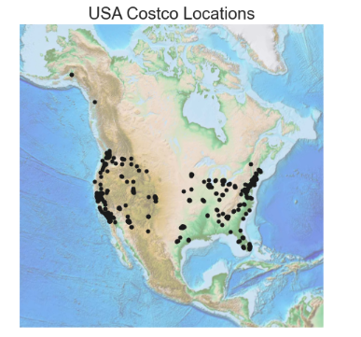
Python – Spatial Plot

Slide 4
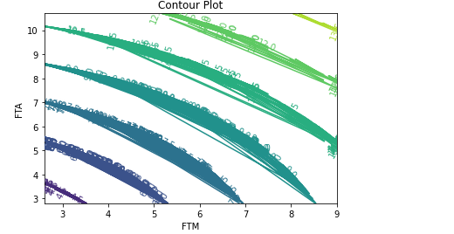
Python – Contour Plot

Slide 5
Power BI

Slide 6
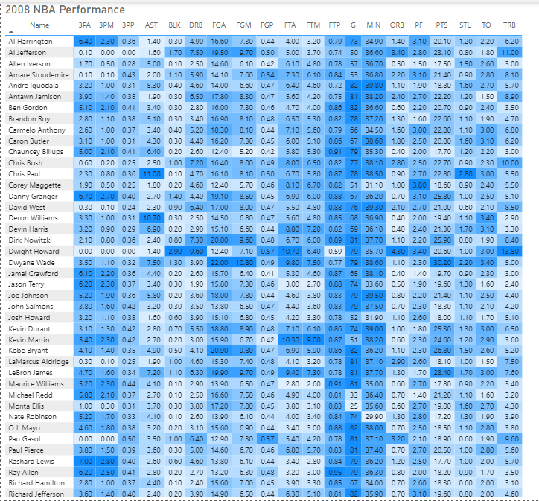
Power BI – Heat Map

Slide 7
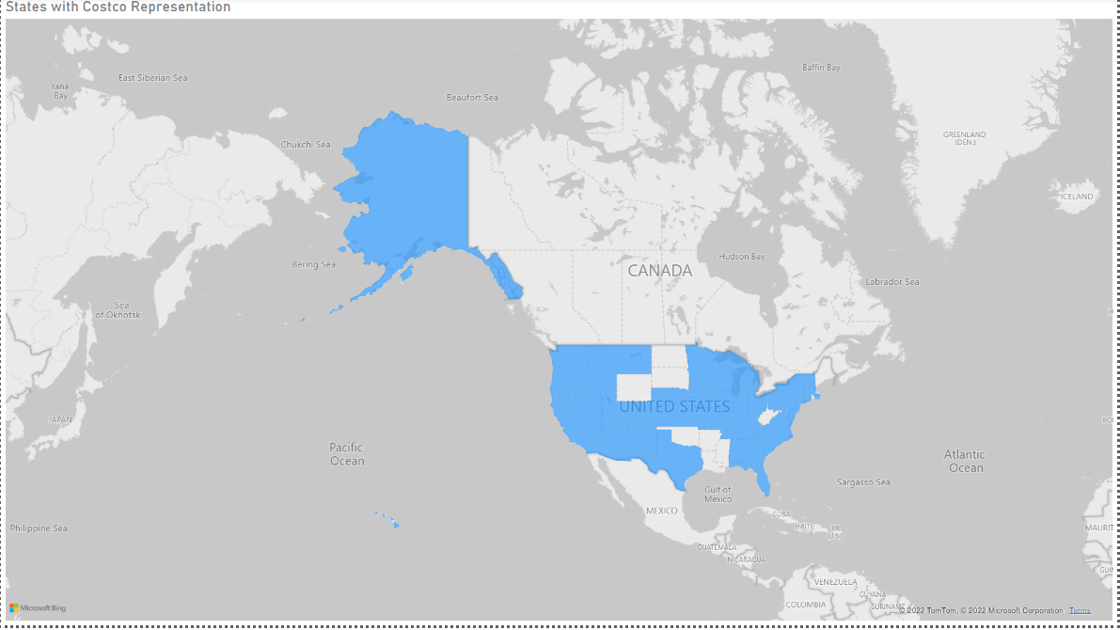
Power BI – Spatial Chart

Slide 8
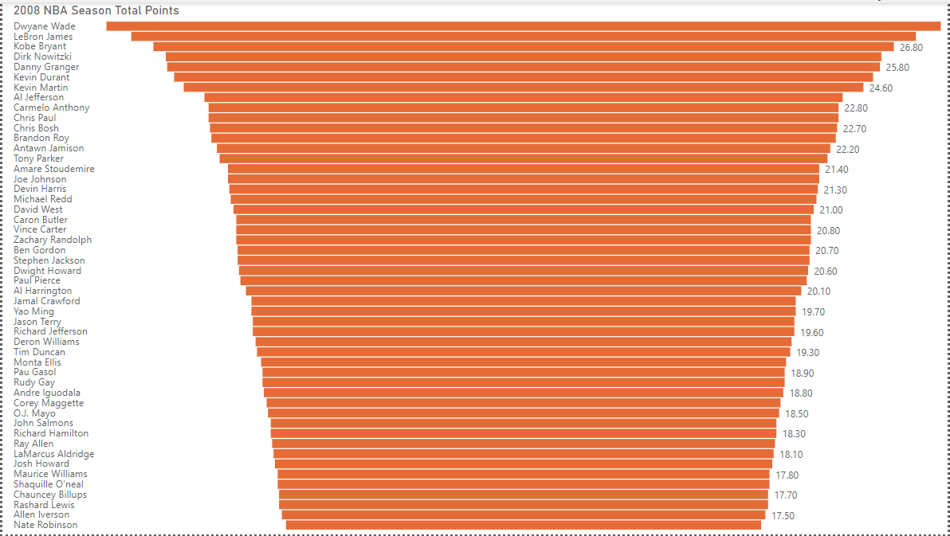
Power BI – Funnel Chart

Slide 9
R

Slide 10
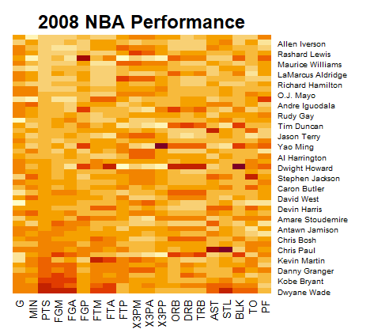
R – Heat Map

Slide 11
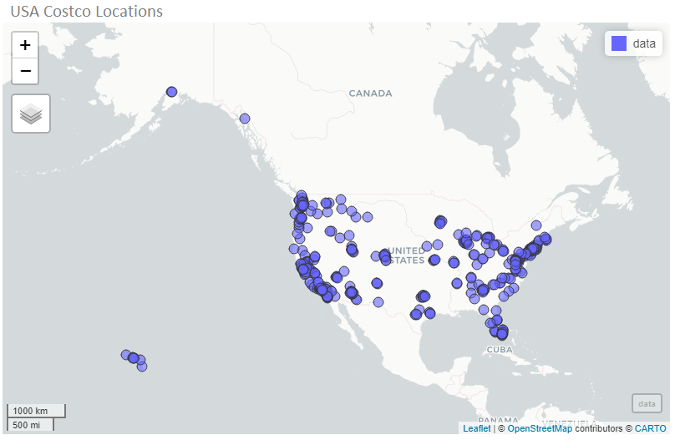
R – Spatial Chart

Slide 12
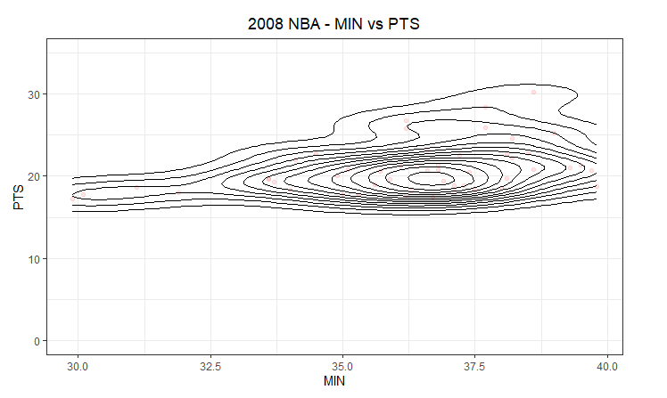
R – Contour Chart

